Slide 1
Knowledge Graph

Slide 2
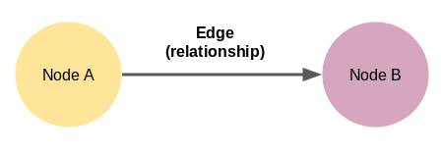
Introduction
What is knowledge Graph?
A knowledge graph is a way of storing data that resulted from an information extraction task. Many basic implementations of knowledge graphs make use of a concept we call triple, that is a set of three items(a subject, a predicate and an object) that we can use to store information about something.

Slide 3
Data description
975
Number of instances: 2747 (Words)
Features:
Inputs:(Text: ”info about of Elon Musk”)

Slide 4
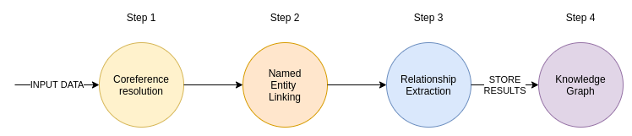
The Information Extraction Pipeline

Slide 5
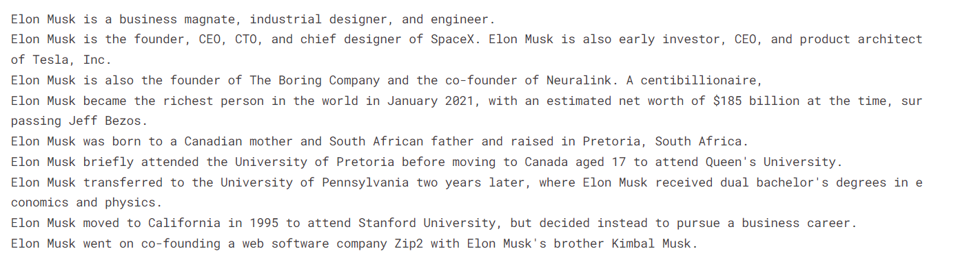

Coreference resolution
The coreference resolution tries to find all expressions in the text that refer to a specific entity
By Using :

Slide 6
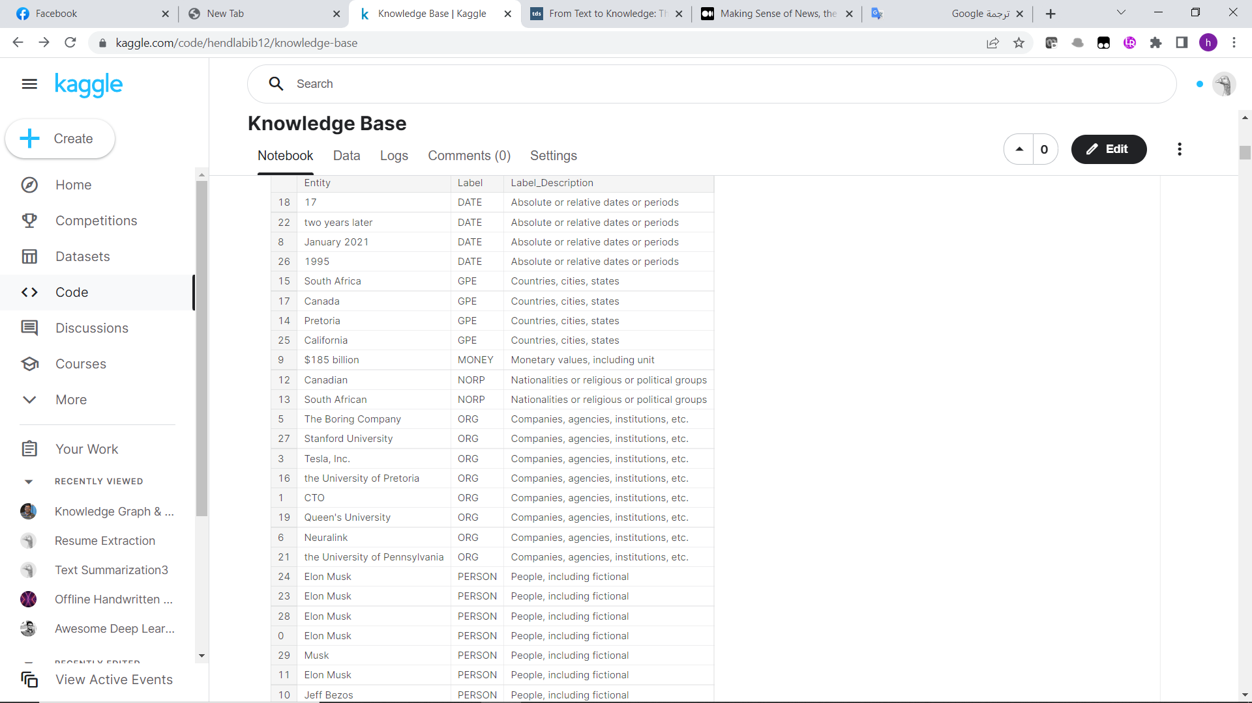
Named Entity Linking
I used spacy and NLTK

Slide 7
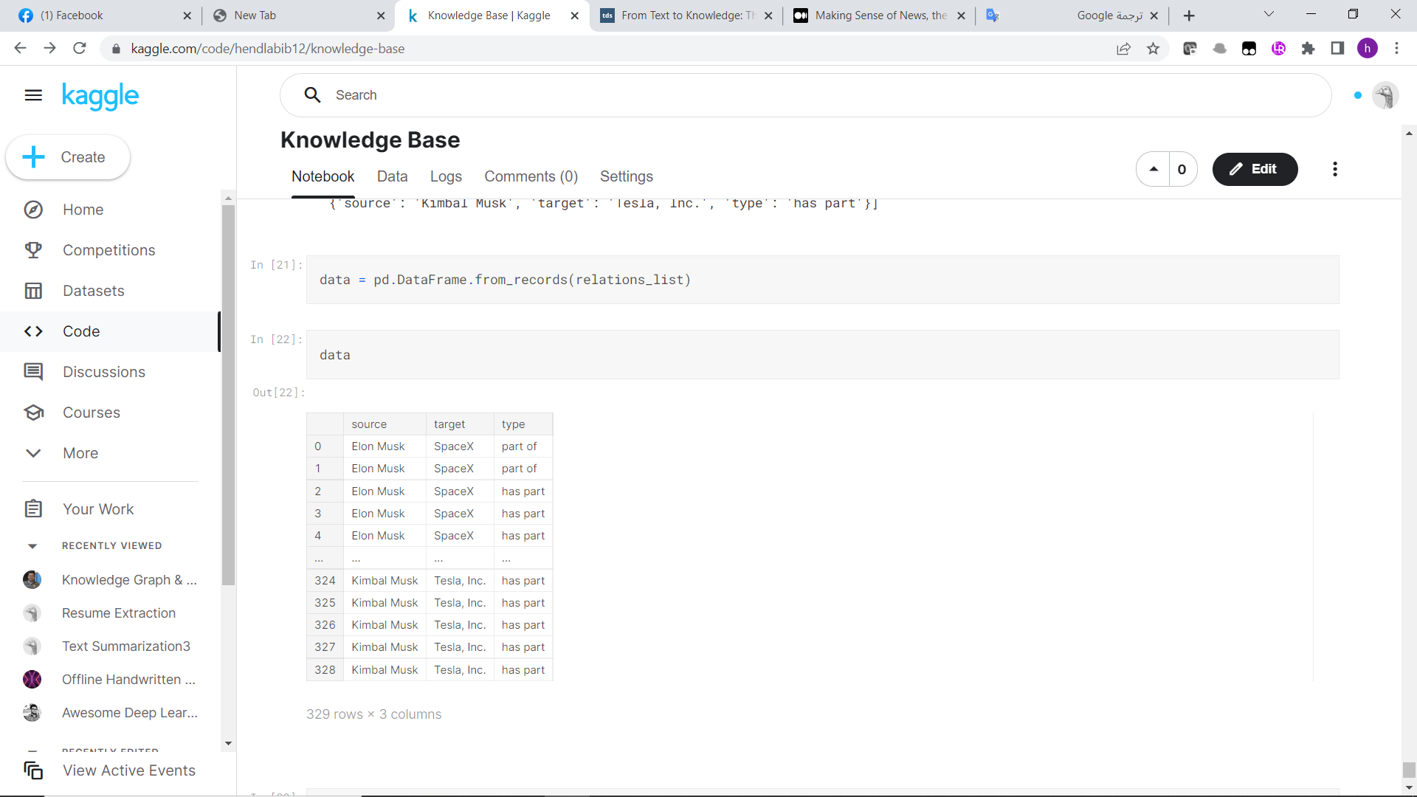
Relationship extraction
I have used the wiki80_bert_softmax model. As the name implies, it uses the BERT encoder under the hood

Slide 8
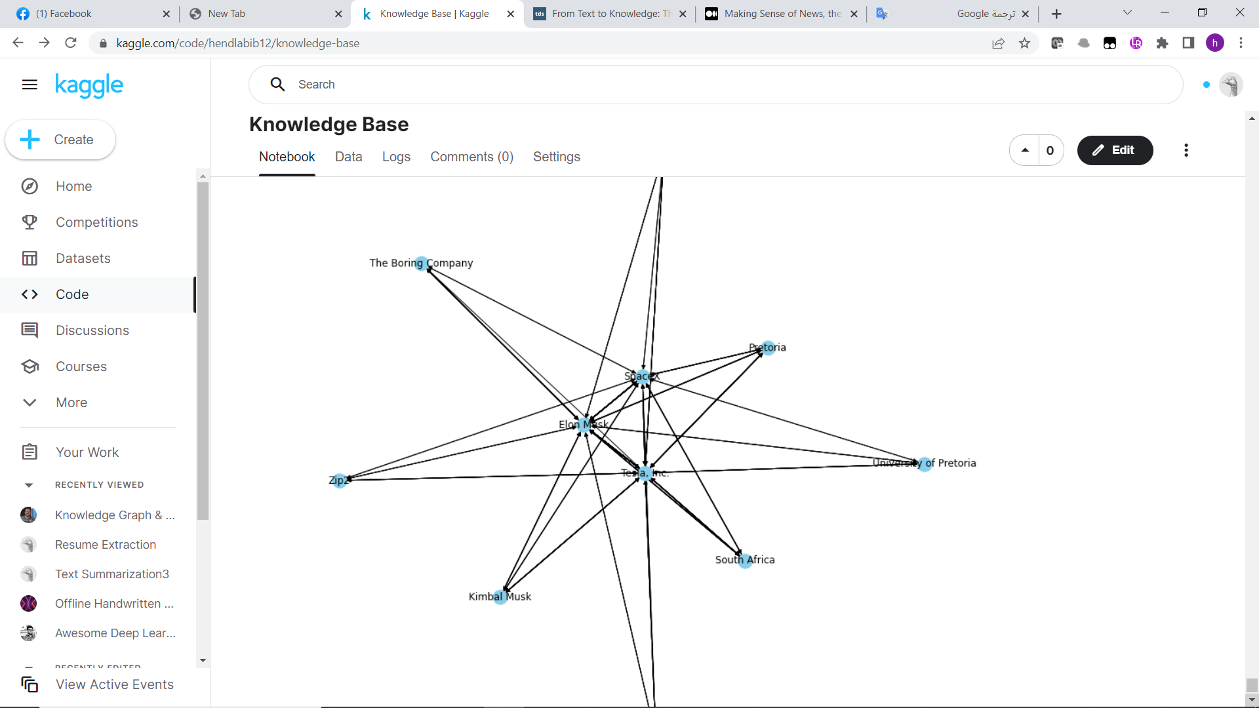
Knowledge graph
I used MultiDiGraph

Slide 9
Questions
What was the biggest challenge you faced when carrying out this project?
I didn’t face any problem in this project.
What do you think you have learned from the project?
The pipeline of knowledge graph and a lot new techniques like GraphDatabase .

